Slide 1
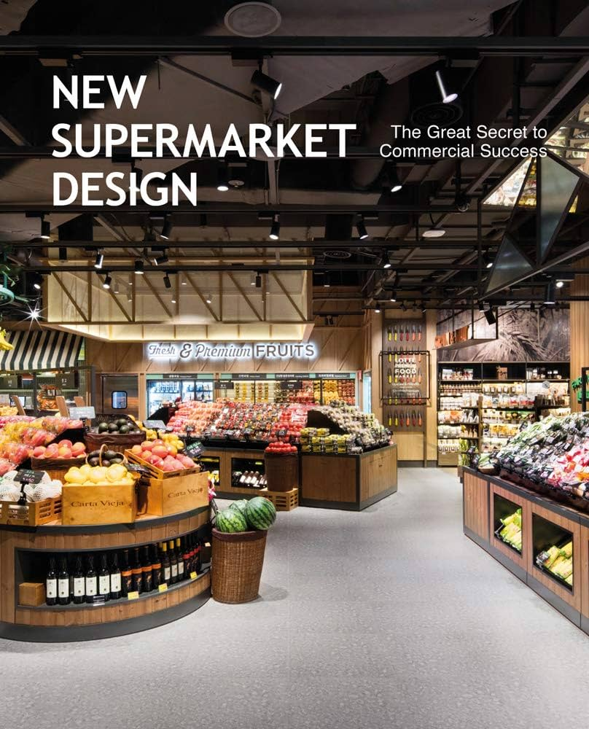
Supermarket Database Project
A Comprehensive Approach to Database Design and Analysis
By Uday Raval

Slide 2

Project Overview
Objective:
To design a relational database for managing supermarket operations, including employees, products, orders, and customers.
Scope:
ER Diagram creation.
Relational schema design and normalization.
SQL table creation, data insertion, and querying.
Deliverables:
Functional database.
SQL queries for insights.
Analysis of challenges and outcomes.

Slide 3
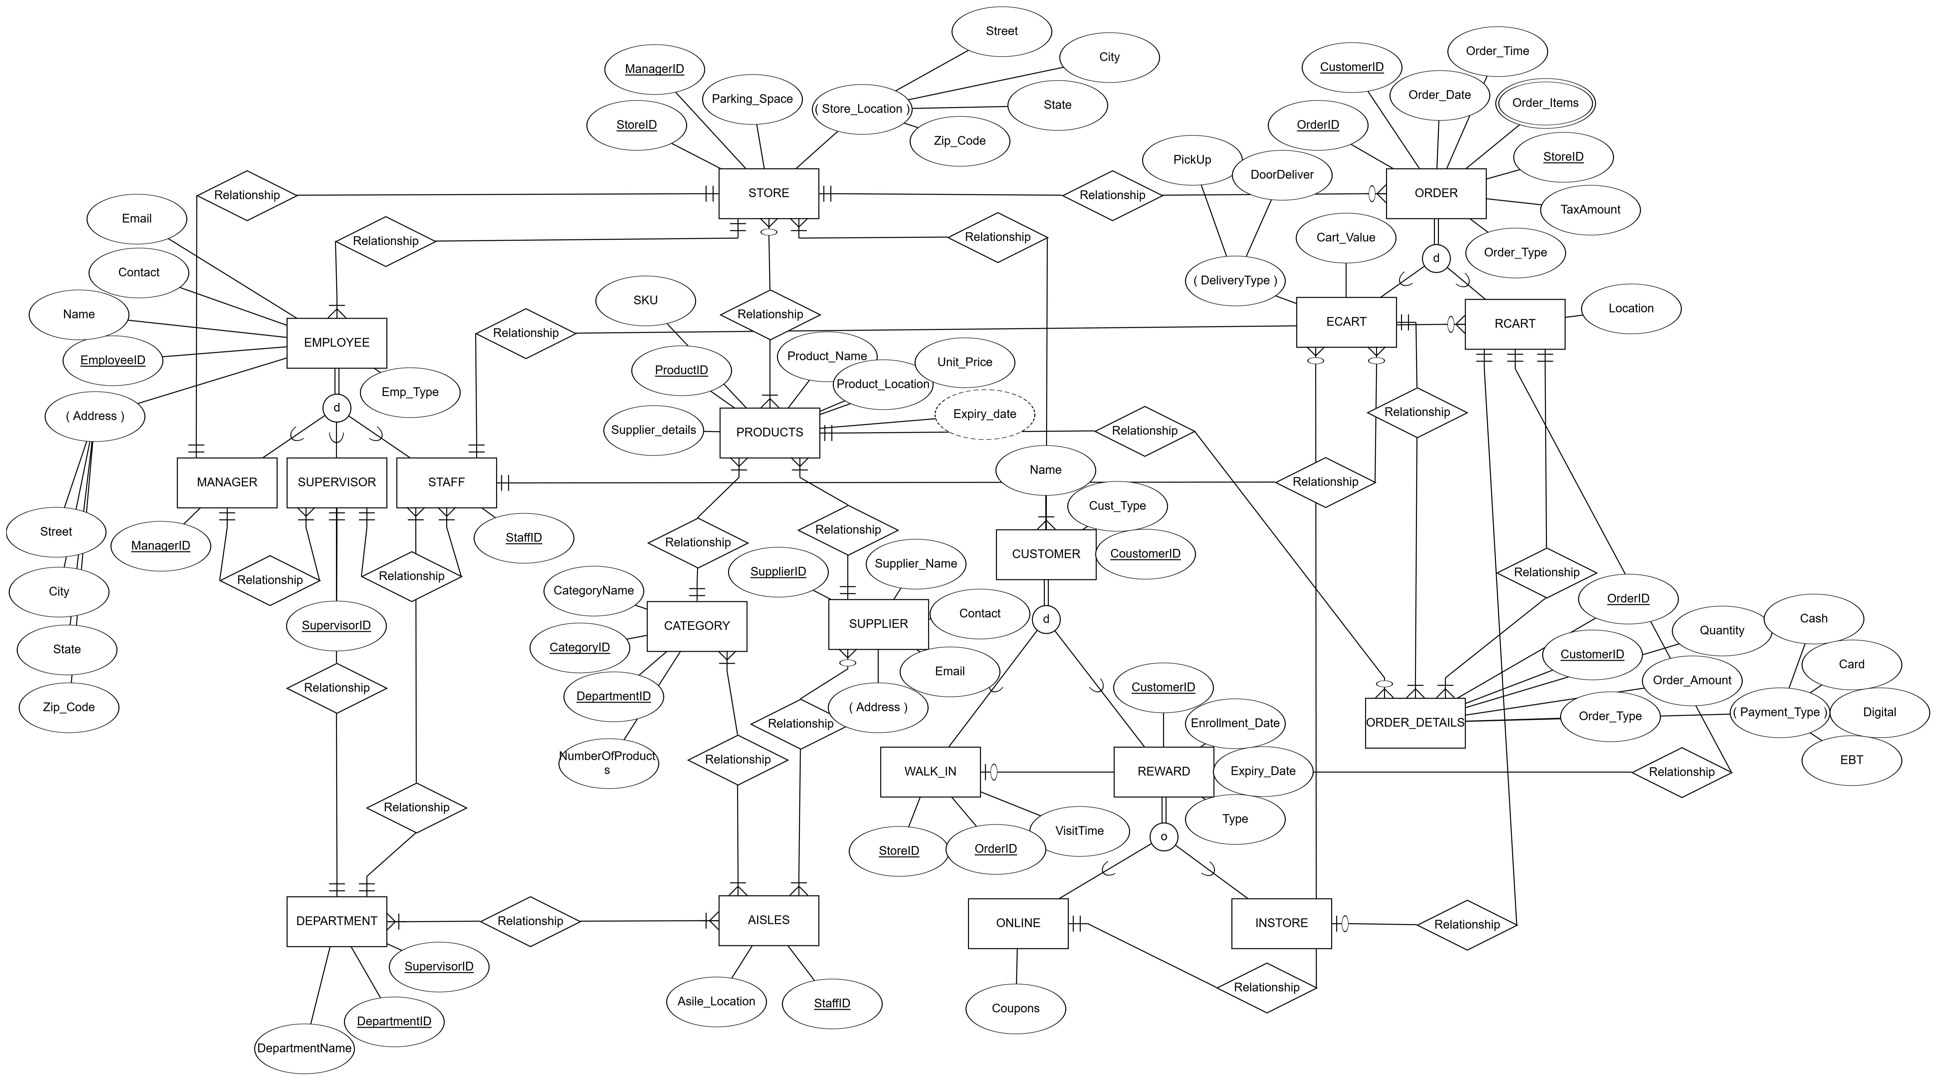
ER Diagram

Slide 4
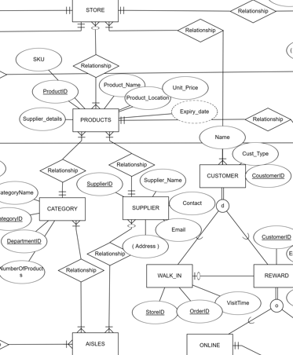
ER DIAGRAM Content
Include the ER diagram (from the uploaded image).Highlight main entities:
EMPLOYEE: Tracks staff details.
STORE: Represents supermarket locations.
PRODUCTS: Catalog of items sold.
CUSTOMER: Includes customer details and rewards.
ORDER: Stores purchase transactions.
Add callouts for relationships (e.g., EMPLOYEE supervises STORE).

Slide 5
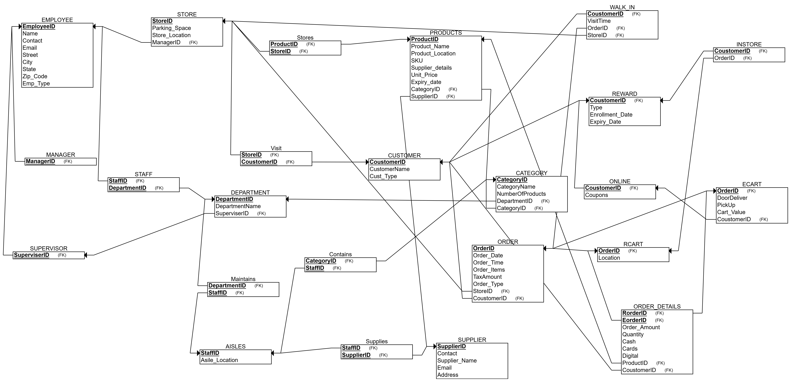
Relational Schema
Description:
Show the converted schema.
List key tables:
EMPLOYEE, STORE, PRODUCTS, CUSTOMER, ORDER, etc.
Highlight key features:
Primary Keys: Unique identifiers for entities (e.g., EmployeeID, ProductID).
Foreign Keys: Ensure relationships (e.g., ManagerID in STORE referencing EMPLOYEE).
Normalization: Explain the use of 3NF for data efficiency.
Use a clean table diagram or bullets for each table and its attributes.

Slide 6
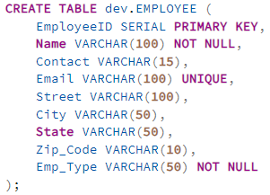
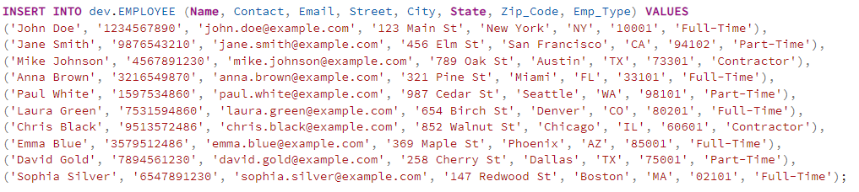
SQL Implementation
Data Insertion:
Example EMPLOYEE
Content: Table Creation
Show an example:
EMPLOYEE table creation script.

Slide 7
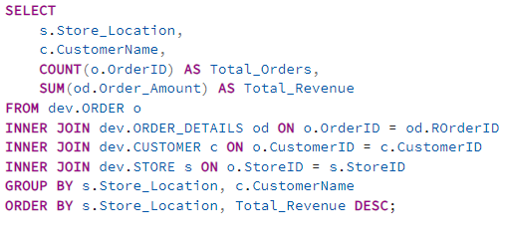
Query 1 - Total Orders and Revenue per Customer by Store Location
Objective: Identify customer behavior and revenue per store.

Slide 8
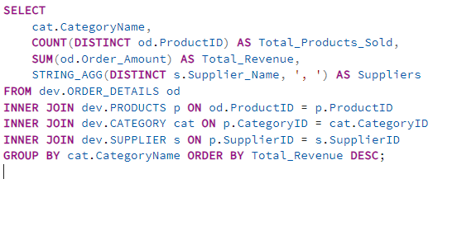
Query 2 - Products Sold per Category with Revenue and Suppliers
Objective: Analyze category-wise performance and supplier contributions.

Slide 9
Challenges & Achievements
Key Issues:
Vague Naming: Ambiguous table and column names led to confusion.
Inconsistent Data Types: E.g., Phone and Zip_Code should be standardized.
Key Generation: Manual assignment of primary keys was error-prone.
Successes:
Accurate relational schema translation.
Smooth conversion to SQL.
Successful validation and testing of queries.

Slide 10
Key Learnings & Future Improvements
Technical Insights:
Importance of designing normalized databases.
Efficient query writing and troubleshooting.
Teamwork:
Improved collaboration and task allocation.
Growth Areas:
Consistency in naming conventions.
Ensuring data integrity at all stages.
Suggestions:
Use automated tools for schema visualization.
Introduce indexes for faster query execution.
Regular audits to ensure data consistency.

Slide 11
Conclusion
This project successfully demonstrated the design and implementation of a robust database for supermarket operations, covering employees, products, customers, and orders.
We gained valuable insights into customer behavior and product performance through SQL queries.
The process enhanced our understanding of database normalization, query optimization, and teamwork.
Future improvements include refining naming conventions and improving data consistency to enhance scalability and performance.

Slide 12


